Slide 1
Hi, I’m Kevin.

Slide 2
And this is my Presentation

Slide 3
On Transport of London

Slide 4
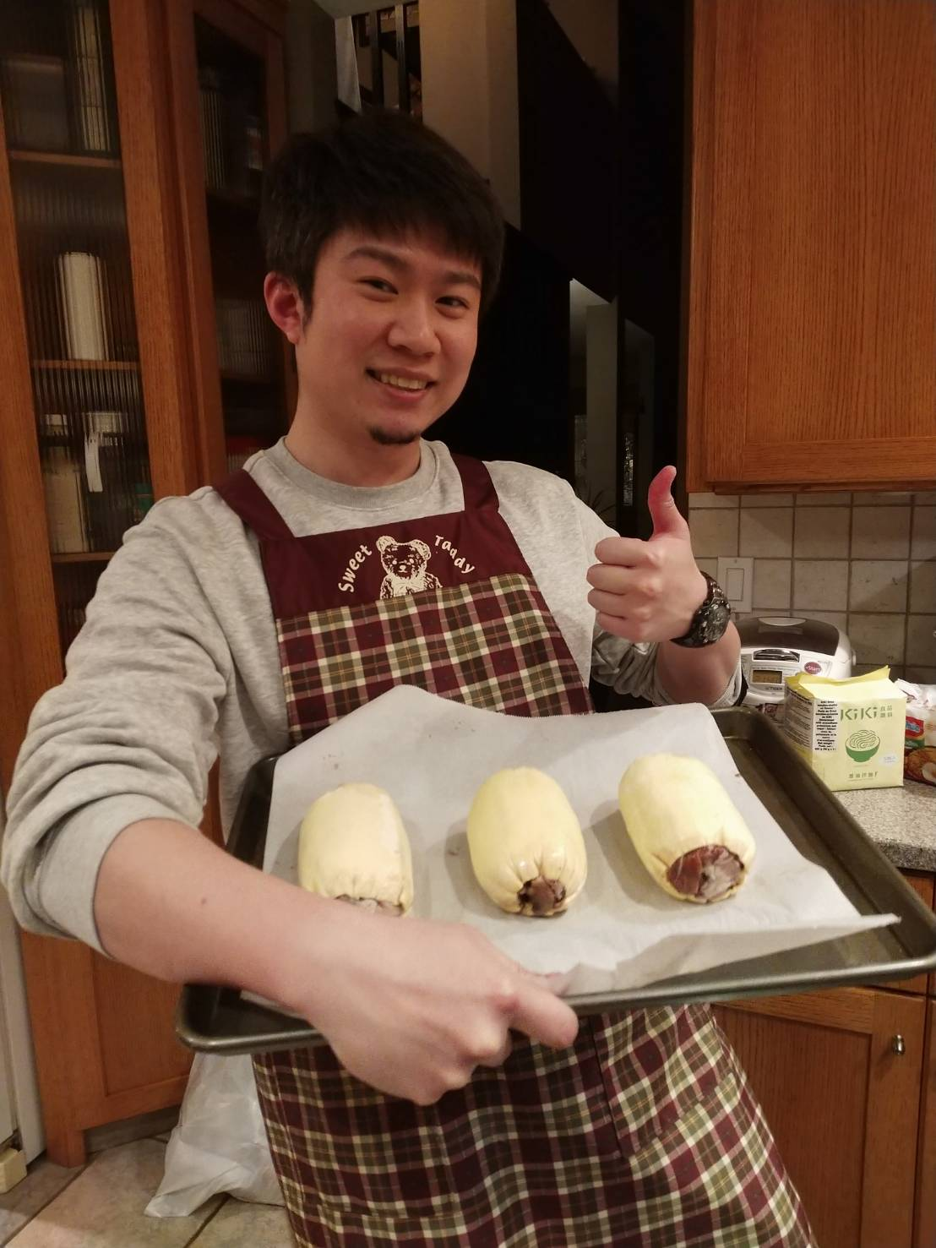

Slide 5
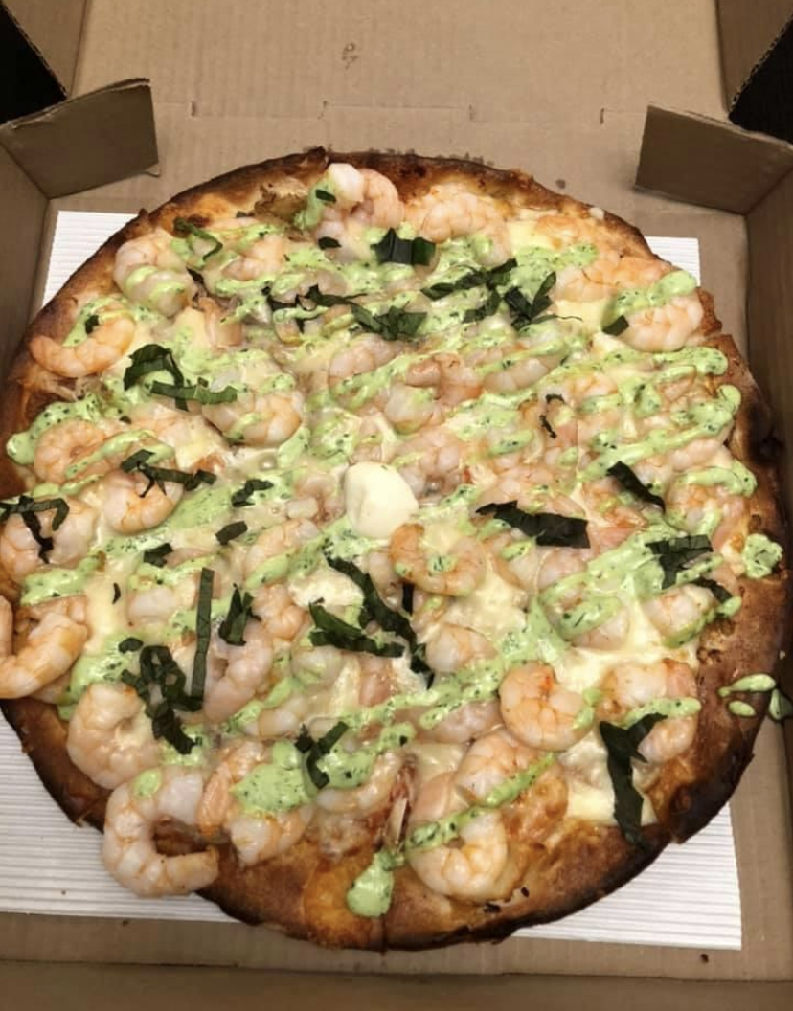

Slide 6
Problem: How should I go to work?

Slide 7
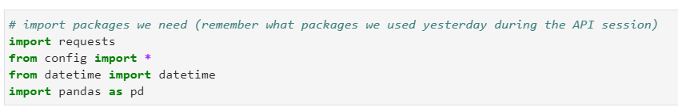
What did I use?

Slide 8
Real question… Do I go to work?

Slide 9
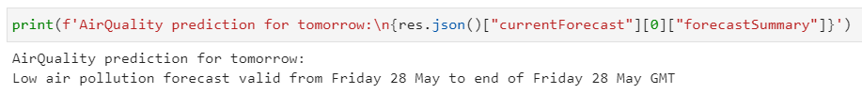

Slide 10
Guess I have to…

Slide 11
But how?

Slide 12
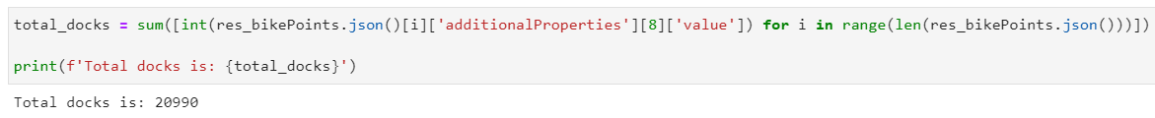

Slide 13
Who likes bikes anyway?!

Slide 14
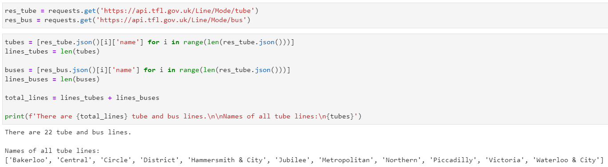

Slide 15
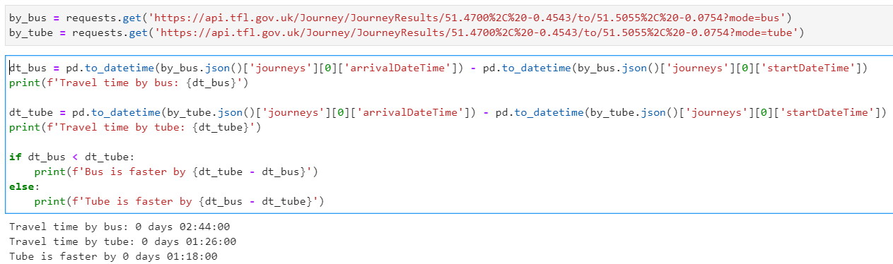

Slide 16
Guess I really have to go to work…

Slide 17
